Slide 1

Electronic and Information Resources (EIR) Accessibility in Contracts/Procurements

Slide 2
Learning Objectives
What Does Electronic Information Resources (EIR) Accessibility Mean and Who is Affected
What Laws and Guidelines Apply to EIR Accessibility
Accessibility in Procurement
Representations, Warranties, Remedies
EIR Process Flow Steps
What if We Can’t Make EIR Accessible?
Recent DIR Rules Changes in 1 TAC 213
EIR Accessibility Resources
2/15/2017
EIR Accessibility in Contracts/Procurements
2

Slide 3
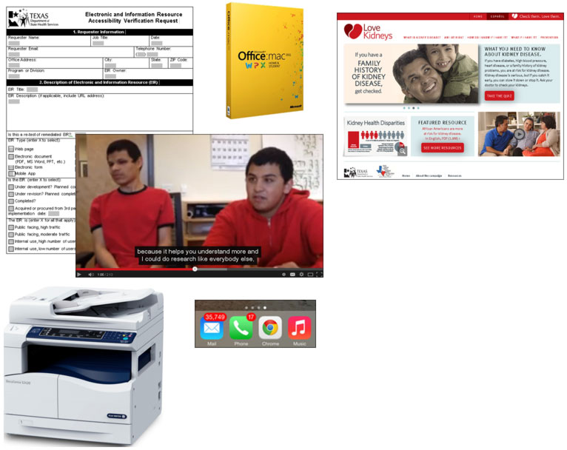
What are Electronic and Information Resources (EIR)?
Websites
Multimedia
Software
Documents (PDF, Office)
Mobile applications
Online training & webinars
Hardware or office equipment with IT components
Telecommunication products
2/15/2017
EIR Accessibility in Contracts/Procurements
3
Notes:
SLIDE 3 - What are Electronic and Information Resources (EIR)?
Electronic and information resources - All of these apply, but for our purposes we are going to focus on documents and forms, software, and web browser based applications.
If it is a document of some sort, that is pretty obvious--a Word, Excel, PowerPoint, or PDF file. That is all EIR. If something is a software program--something you launch on your computer--or it is some sort of application like CAPPS that launches through your browser--that is EIR. It needs a user interface.

Slide 4
What Does Accessibility Mean?
Accessibility means providing equal access to information and services regardless of a user's physical or developmental abilities or impairments.
HHS employees are required by law and system policy to ensure that any electronic information or technology resources that are created or purchased are accessible to both employees and the public with and without disabilities.
2/15/2017
EIR Accessibility in Contracts/Procurements
4
Notes:
SLIDE 4 - What does accessibility mean?
Accessibility means providing equal access to information and services regardless of a user's physical or developmental abilities or impairments.

Slide 5
POUR
Perceivable
Information and user interface components must be presentable to users in ways they can perceive.
Operable
User interface components and navigation must be operable.
Understandable
Information and the operation of user interface must be understandable.
Robust
Content must be robust enough that it can be interpreted reliably by a wide variety of user agents, including assistive technologies.
2/15/2017
EIR Accessibility in Contracts/Procurements
5
Notes:
SLIDE 5
Electronic information and resources need to be perceivable, operable, understandable, and robust.
Perceivable- through sight, hearing, and touch. Text (perceivable by sight) can be transformed into audio by using a text-to-speech screen reader (perceivable by hearing) and into Braille by using a refreshable Braille display (perceivable by touch).
Operable or navigable using various input methods. Not everyone uses a mouse. Individuals may use a keyboard or an onscreen keyboard, voice input.
Understandable - Writing the content in plain language. Is navigation system consistent? Fonts that are bad for dyslexia?
Robust - mobile vs. desktop, Windows vs. Macintosh, Android vs, iPhone, Internet Explorer vs. Google Chrome, latest and greatest vs. something that might be dated.

Slide 6
What Laws & Policies Require EIR to Be Accessible?
Accessibility doesn’t just apply to the public sector. Private sector also responsible for providing accessible EIR. Standards and laws HHS agencies must follow include:
Rehabilitation Act of 1973, Section 508
section508.gov
Texas Government Code, Chapter 2054, Subchapter M
www.statutes.legis.state.tx.us/SOTWDocs/GV/htm/GV.2054.htm
1 Texas Administrative Code, Chapters 206 and 213
texreg.sos.state.tx.us/public/readtac$ext.ViewTAC?tac_view=4&ti=1&pt=10&ch=206 and texreg.sos.state.tx.us/public/readtac$ext.ViewTAC?tac_view=4&ti=1&pt=10&ch=213
HHS EIR Accessibility Policy
accessibility.hhs.texas.gov/policy.asp
2/15/2017
EIR Accessibility in Contracts/Procurements
6
Notes:
SLIDES 6-7
There are federal and state laws, as well as HHS policy that apply to accessibility. In 2015, there was even a change to TAC 213 that relates to the procurement of EIR--more on that later.
Reason I am here is because of these laws. Failure to follow could result in a complaint, lawsuit, bad reputation of agency. It could be discrimination issue for employee. In 2015, 3 Texas counties were investigated by the U.S. Dept. of Justice because of failure to meet these laws. Cite case in Galveston where a blind person could not fill out a form to appear at a public hearing. The signup form could have been one page on a website or a one PDF or Word file--and it prevented people who are blind from participating. Galveston, McLennan, Nueces counties
In 2005, HHSC was sued and lost because its EPSDT application (Texas Health Steps) used PhD level of English.
HHSC was sued in 2016 over YourTexasBenefits—application was fixed and suit was dropped
DOJ is already looking at payroll issues for DFPS.

Slide 7
Accessibility and Procurement - Policy
Texas Administrative Code (TAC), Title 1, Part 10, Chapter 213, Subchapter B, Rule §213.18
texreg.sos.state.tx.us/public/readtac$ext.TacPage?sl=R&app=9&p_dir=&p_rloc=&p_tloc=&p_ploc=&pg=1&p_tac=&ti=1&pt=10&ch=213&rl=18
HHS EIR Accessibility Policy Manual
accessibility.hhs.texas.gov/policy_htm/default.htm
2/15/2017
EIR Accessibility in Contracts/Procurements
7

Slide 8
Who Benefits From Accessibility?
Visually-impaired
Blindness
Low vision
Color vision deficiency
Hearing-impaired
Deafness
Hard-of-hearing
Motor Control-impaired
Inability to use a mouse
Lack of fine motor control
Paralysis or loss of limb
Cognitive-impaired
Dyslexia
Memory or Attention Disorders
2/15/2017
EIR Accessibility in Contracts/Procurements
8
Notes:
SLIDE 8 - Who benefits
These are some examples of people with disabilities who benefit from accessible EIR
Who is affected?
People with visual impairments including no vision, low-vision, color-blindness
People with hearing impairments including those who are deaf or hard-of-hearing or who have problems with speech
People with motor control issues who can’t use a mouse or must use keyboard only or specialized input devices
People with cognitive disabilities

Slide 9

Assistive Technology
2/15/2017
EIR Accessibility in Contracts/Procurements
9
Notes:
How do these people access information?
Assistive technology such as screen readers, screen magnifiers, keyboard only access, speech to text input programs, specialized input devices
SLIDES 9-10 - Assistive Technology
How do these people access information?
People with disabilities used assistive technology such as screen readers, screen magnifiers, keyboard only access to use their computers like anyone else.
Screen readers are software programs that allow blind or visually impaired users to read information from a computer screen. The software interprets the information and using a speech synthesizer reads it out loud. User navigates computer and info using a keyboard only with different combos of keystrokes.

Slide 10
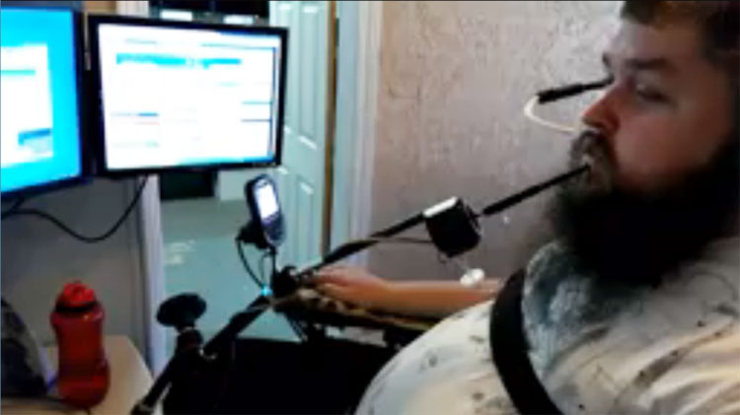
Assistive Technology (Cont)
2/15/2017
EIR Accessibility in Contracts/Procurements
10

Slide 11

Do We Really Have to Do This?
2/15/2017
EIR Accessibility in Contracts/Procurements
11
Notes:
Yes. I cited the laws and the lawsuits already. Also, this particular issue was inspiration for me being here today. Last summer, we had 3 conferences being hosted on an external site. The program areas must have gotten with someone who had purchasing ability.
Bottom line was if you were blind and wanted to attend a conference, you couldn't register. That's discrimination.
Whoever purchased had broken other rules by doing this. All website related purchases need to go through Web Services (headed by Tray Ivie), DSHS Communications (headed by Melissa Loe), and now through the HHS Portal Authority. If program area wants to buy some sort of website, please try to make sure one of us is aware.

Slide 12
Social and Legal Responsibility
Around 10% percent of the world’s population (about 650 million people) are disabled. ¹
Nearly one in five Americans have a disability. ²
The Texas Department of Information Resources (DIR) rules changes in the 1 TAC 213 became effective January 1, 2015, affecting the procurement of all EIR goods and services, and require new HHS business processes and data collection for EIR procurements.
¹ U.N. Convention on the Rights of Persons with Disabilities ² United States Census Bureau
2/15/2017
EIR Accessibility in Contracts/Procurements
12
Notes:
• From 2008 to 2011, about 12% of the U.S. population had a disability. In 2011, the total was 37,200,000
• In 2011, the number of Texans with disabilities was 2,906,416 or 11.5 percent of the population. Texas has the second highest population of people with disabilities. Texas has more people with disabilities than Florida (a state often associated with retirees).
• According to the Texas Health and Human Services Commission, DSHS employees about 12,000 people staff statewide. If 11.5% of Texans have disabilities, that means that about 1,380 DSHS staff have disabilities.
I have more on the specifics to the changes in TAC 213 toward the end of this presentation.

Slide 13
Accessibility in Procurement
Goals
to purchase the most accessible products and services
to ensure effective, efficient, and equal access to EIR
to comply with Federal, State, and Enterprise EIR Accessibility standards
2/15/2017
EIR Accessibility in Contracts/Procurements
13
Notes:
SLIDE 13 - Goals for accessibility in procurement
· to purchase the most accessible products and services
· to ensure effective, efficient, and equal access to EIR
· to comply with Federal, State, and Enterprise EIR Accessibility standards

Slide 14
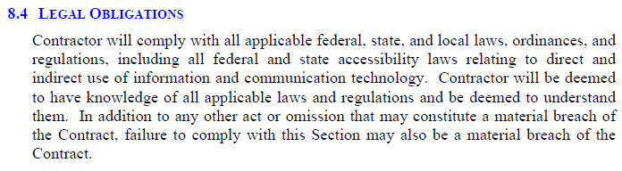
HHS EIR Accessibility Clause
Where have I seen that?
Historically the “HHS Uniform EIR Accessibility Clause” was included in the HHS Uniform Terms and Conditions (UTCs).
The current UTCs (version 2.13) contain a single broad statement requiring vendor compliance with all federal, state and local regulations including those requiring the accessibility.
To be contractually compliant, specific accessibility requirements must be included by adding the “Special Conditions” attachment to the Signature Page document of a Procurement Package.
2/15/2017
EIR Accessibility in Contracts/Procurements
14
Notes:
SLIDE 14
This accessibility clause content used to be utilized as an attachment, or the text has been inserted into content – usually within the SOW. You may have seen a direct or indirect reference to the DSHS General Provisions accessibility content.
This language used to be part of the HHS Uniform Terms and Conditions. Recently, the UTCs were changed and the accessibility language was shortened. As a result, accessibility requirements must be included by adding the Special Conditions attachment. Contracts for EIR/ICT still should have the warranty clause that requires that the vendor tell us about the accessibility of their product and warrant that the information that they have provided is true or that they will fix it as a material defect. The general statement language is not very enforceable since those laws place the burden of providing accessibility on the agency
Accessibility is covered in the Vendor Supplemental & Special Conditions Attachment - REV 11.15.16, Section 1.16 is Electronic and Information Resources Accessibility and Security Standards

Slide 15
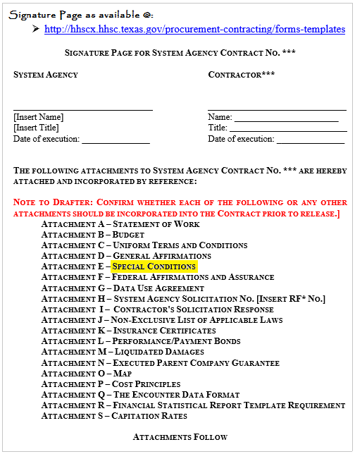
HHS EIR Accessibility Clause (Cont)
Compliance requires that Procurement, Contracting and Legal staff recognize all contracts that may include the provision of accessible Electronic Information Resources (EIR) by the contractor or vendor, ensuring the HHS Accessibility requirements are included in the Signature Page document, by utilizing the Special Conditions attachment.
Special Condition attachments found at COS’s “Legal Contract Templates and Guidance”: http://online.dshs.state.tx.us/Chief-Financial-Officer/contracts/Legal-Contract-Templates-and-Guidance.aspx
2/15/2017
EIR Accessibility in Contracts/Procurements
15
Notes:
SLIDE 15
Compliance requires that Procurement, Contracting and Legal staff recognize all contracts that may include the provision of accessible Electronic Information Resources (EIR) by the contractor or vendor, ensuring the HHS Accessibility requirements are included in the Signature Page document, by utilizing the Special Conditions attachment.

Slide 16
Applicable to EIR Direct Use
The EIR must be accessible when purchasing or leasing EIR goods or services to fulfill a detailed contract specification or statement of work. Common direct use examples include:
software used on DSHS internal or external websites
copiers and multi-function copiers that will be used by DSHS employees
software or websites used by DSHS employees or contractors
services provided through externally hosted websites used by the public or DSHS employees
2/15/2017
EIR Accessibility in Contracts/Procurements
16
Notes:
SLIDE 16 - Direct Use
These type of items also include websites that promote a certain promotional campaign, like YesQuit, WIC program, etc. These are the most common.
We don't have to worry as much about copier and muli-function items because HHS takes care of these. When I worked at DARS, I was part of testing team for current Xerox workstations. We even tested whether or not a person in a wheelchair could add more paper or change toner.

Slide 17
Applicable to EIR Indirect Use
The EIR must be accessible when a vendor’s use of EIR is to fulfill a contract for goods or services. Common indirect use examples include:
contracting for HR services delivered through a website or telephone system;
contracting for wellness services delivered through Web-based multimedia or video conferencing system.
contracting for training or technical support delivered through e-handbooks or forms, or through a Web-based or telephone system;
purchasing transaction services that require the public to interact with EIR through interoperable controls, video screens, menus, or websites as in the use of a debit card reader or ticket kiosk.
2/15/2017
EIR Accessibility in Contracts/Procurements
17
Notes:
SLIDE 17 - Indirect Use
Let's say we contracted with an agency to provide some sort of public health services. To get served, a person has to register through that agency's website. What if the registration forms are not accessible? What if they have some sort of training videos that are not closed captioned?

Slide 18
Not Applicable To EIR Incidental Use
DSHS will not require EIR to be accessible when EIR is considered incidental or insignificant - common use examples include :
EIR will not be used or accessed by employees or members of the public in the performance of the contract
Ex.: vendor has internal email system for use by its employees
EIR will not become the property of the agency
Ex.: vendor has automated time & leave system for use by its employees
EIR is used by a contractor's employees to access or manipulate information that is not used by DSHS employees or the public
Ex.: vendor has testing software to test its products before release
2/15/2017
EIR Accessibility in Contracts/Procurements
18
Notes:
SLIDE 18 - Incidental Use
This is pretty straight forward. If the same provider of mental health/substance abuse services has an email system for its employees that is not accessible, it's not covered. If that agency has an internal website or newsletter that is not accessible, it's not covered.

Slide 19
Evaluation, Testing, and Monitoring
Compliance is a primary selection factor and must be verified.
DSHS may review, test, evaluate, and monitor a vendor’s product before and after the contract is awarded. Failure to do so does not waive the vendor’s responsibility to comply.
Contract managers, program staff, and the DSHS EIR Accessibility Coordinator work together to monitor vendor performance to ensure goods and services are accessible as required in the contract.
2/15/2017
EIR Accessibility in Contracts/Procurements
19
Notes:
SLIDE 19 - Evaluation, Testing, and Monitoring
The reason why I emphasized federal, state, and HHS policy, is because each one gets more granular.
The federal law asks for a certain level of due diligence. The state law does the same, but it also requires us to have something called an exception process, which includes provided an alternative means of accessing the information. A combination of the state and HHS policy and best practice is to actually test and evaluate EIR. It's not enough for a a vendor to say they produced something that is accessible. HHS uses standard tools and DSHS uses the same tools to evaluate EIR. DSHS follows the same SOW template and uses the same UTC as HHS, which contractually obligate vendors to deliver accessible products. It is up to us to verify they are live up to their end of the bargain.

Slide 20
Representations and Warranties
As of the effective date of the contract, the product or service will comply with the accessibility standards agreed upon in the negotiated project contract.
If Contractor or DSHS discovers a product or service does not comply with acceptable standards, the Contactor will, in a timely manner and at no cost to DSHS, remediate, replace, and upgrade the product or service, or provide a suitable substitute in the case of non-compliance.
Contractor’s representations and warranties under this subsection will survive the termination or expiration of the Contract and will remain in full force and effect throughout the useful life of the Product.
2/15/2017
EIR Accessibility in Contracts/Procurements
20
Notes:
SLIDE 20 - Representations and Warranties
This is the backbone of my work. If a contract or SOW doesn't include some sort of accessibility provision, then we don't have a leg to stand on and we are breaking, federal and state law and HHS policy.
Vendors who produce EIR and choose to do business with us need to know terms and conditions include delivering EIR that is accessible. Case closed. If you can't do this, don't enter into a contract with us. If we let vendors get away delivering inaccessible EIR, we put ourselves at risk.
Example: We require some staff to use a timekeeping program. There are a limited number of vendors and none of them has an accessible product. We have blind staff who have trouble with it, yet they must use it. We recently renewed the contract and the vendor promises to fix but is not delivering--they have been fibbing for at least 2 years on this. My job is to raise a flag, avoid EEOC complaint. There is a workaround with Excel.

Slide 21
Remedies
Breach of Contract: The Contractor will be liable for direct and consequential damages, and any other remedies to which DSHS may be entitled:
Under Tex. Gov’t Code § 2054.465, neither the Contractor nor any other person has cause of action against DSHS for a claim of a failure to comply with Tex. Gov’t Code Chapter 2054, Subchapter M, and rules of the Department of Information Resources.
In the event of a breach of Contractor’s representations and warranties, Contractor will be liable for direct, consequential, indirect, special, or liquidated damages and any other remedies to which DSHS may be entitled under this Contract and other applicable law. This remedy is cumulative of any other remedies to which DSHS may be entitled under this Contract and other applicable law.
2/15/2017
EIR Accessibility in Contracts/Procurements
21
Notes:
SLIDE 21 - Remedies
I think this pretty straight forward for any breach of contract situation. Contractor is for direct and consequential damages, and any other remedies to which DSHS may be entitled.

Slide 22
EIR Process Flow Steps
Requestor includes the accessibility requirements in the solicitation document.
Requestor routes the solicitation for internal agency review, comments, and approval.
Requestor submits purchase request and PCS initiates solicitation.
PCS led group - including the EIR Accessibility Coordinator - evaluates the vendor responses.
2/15/2017
EIR Accessibility in Contracts/Procurements
22
Notes:
SLIDES 22-23 - EIR Process Flow Steps
I am working through this now with program areas like Vital Statistics and WIC, which both have major IT projects.
1 and 2. The solicitation included accessibility requirements
3. PCS initiated the process
4. For Vital Statistics, I evaluated the bids based on how the vendors proposed they would meet accessibility requirements and recommended which vendor I thought would best meet them.
5. After contract awarded I have to ensure they are really delivering accessible EIR. If not, I have to initiate something called an exception and determine alternate means of access. More on that later.

Slide 23
EIR Process Flow Steps (cont.)
Is the tentative contract winner compliant with accessibility requirements? If not, Procurement & the EIR Accessibility Coordinator will:
Obtain formal accessibility remediation plan from supplier with a planned compliance date.
Determine the alternative means of access.
Initiate the EIR Accessibility Exception for Conditional Use process.
2/15/2017
EIR Accessibility in Contracts/Procurements
23

Slide 24
EIR Process Flow Steps (cont.)
PCS awards the contract.
Managing divisions implements the contract.
Managing division controls the contract lifecycle and maintenance.
2/15/2017
EIR Accessibility in Contracts/Procurements
24
Notes:
SLIDE 24 6-8 After the contract is awarded and implemented, assuming there are no changes to the software, my job is done. When there is an upgrade, then I have to retest.

Slide 25
What If We Can’t Make EIR Accessible?
The commissioner may grant an exception if no accessible product exists in the marketplace or if remediation creates an undue burden on the agency.
If the results of an EIR accessibility evaluation determine there is a need for an exception, the request must be submitted by the originating division through the EIR Accessibility Coordinator before the final contract is awarded.
If granted, the exception does not eliminate the risks associated with non-accessible EIR nor the responsibility to provide an accessible solution.
2/15/2017
EIR Accessibility in Contracts/Procurements
25
Notes:
SLIDE 25 - What If We Can’t Make EIR Accessible?
Once we have exhausted all possibilities, state law requires me to file an exception with the commissioner. But we are not off the hook. Remember the timekeeping program I mentioned a few slides earlier. We had to come up with a workaround. We can't just say, Oops this thing we are making you do as part of your job in not accessible and because you can't use it you're fired" We have to describe a workaround. Will other staff take on those duties? Will the vendor fix issues in next version?

Slide 26
EIR Accessibility Exception Request (1 of 2)
The EIR Accessibility Exception Request for Conditional Use must provide solid justification for purchasing non-accessible EIR such as:
Non-availability of accessible products in the marketplace;
Underlying inaccessible technology;
Cost prohibitive to make EIR accessible.
Must include an alternative means of access;
Must include a plan for compliance;
Must be approved by the DSHS Commissioner
2/15/2017
EIR Accessibility in Contracts/Procurements
26
Notes:
SLIDES 26, 27 - EIR Accessibility Exception Request
This is about the paperwork I file for the exception request. Some of the checkboxes on the exception form include things like it would be cost prohibitive or there is nothing in the marketplace. When I say cost prohibitive I mean a situation where it would be impossible to do something like scan in millions of medical records and make sure all the PDF files are accessible.
Even so, if a person who was blind wanted a record of some sort, there should be an alternative means of getting the information. A contact email address or phone number. Someone who would ad-hoc respond to these requests.
If you want to see the form, it's on the website, although I am usually the one filling it out and routing to the program area. Note that exceptions can only last a maximum of two years. At the end of that period, we expect vendor to comply.

Slide 27
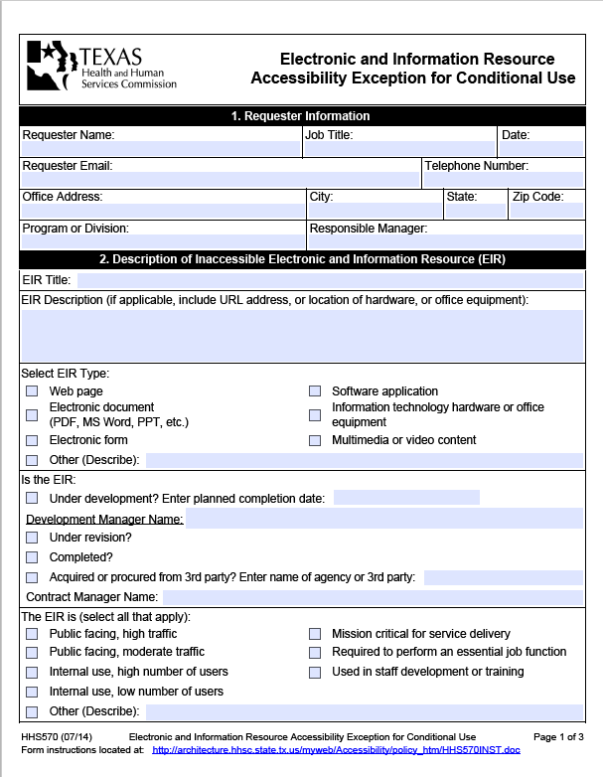
EIR Accessibility Exception Request (2 of 2)
HHS 570 EIR Accessibility Exception Request for Conditional Use
2/15/2017
EIR Accessibility in Contracts/Procurements
27

Slide 28
Recent DIR Rules Changes in 1 TAC 213:
The Department of Information Resources (DIR) rules changes in the 1 TAC 213 became effective January 1, 2015.
These rules affect the procurement of all electronic and information resources (EIR) goods and services, and require new HHS business processes and data collection for EIR procurements.
There are HHS System workgroups actively working to determine these changes impacts, and will recommend business processes, policies and resources to assist the HHS agencies with full compliance with DIR procurement rules.
Much of these statute changes state these changes affect solicitations issued on or after January 1, 2015.
2/15/2017
EIR Accessibility in Contracts/Procurements
28
Notes:
SLIDE 28 - This is information about changes to TAC 213. They may not apply to everyone here, so I will do a quick run through. These are pretty straight forward
The Department of Information Resources (DIR) rules changes to TAC 213 became effective January 1, 2015. This is an overview of those changes.
Note: The change in TAC 213 I’d like to define “commodity”
In this section, “commodity” is defined in Texas Government Code, Chapter 2157.068 as commercial software, hardware, or technology services, other than telecommunications services, that are generally available to businesses or the public and for which the department determines that a reasonable demand exists in two or more state agencies.
(a) The department, in establishing commodity procurement contracts, for which the solicitation is issued on or after January 1, 2015, shall obtain and make available to state agencies all that apply:
(1) accessibility information for products or services, where applicable, through one of the following methods:
(A) the URL to completed Voluntary Product Accessibility Templates (VPATs) or equivalent reporting templates;
(B) accessible electronic documents that address the same accessibility criteria in substantively the same format as VPATs or equivalent reporting templates; or
(C) the URL to a web page which explains how to request completed VPATs, or equivalent reporting templates, for any products under contract;
(2) credible evidence of the vendor's capability or ability to produce accessible EIR products and services. Such evidence may include, but is not limited to, a vendor's internal accessibility policy documents, contractual warranties for accessibility, accessibility testing documents, and examples of prior work results.

Slide 29
Rule §213.17(3) Compliance Exceptions
213.17(3) An approved exception for a significant difficulty or expense under §2054.460, Texas Government Code shall include the following:
date of expiration or duration of the exception;
plan for alternate means of access for persons with disabilities;
justification for the exception;
Documentation of how the agency considered all agency resources available to the program or program component for which the product is being developed, procured, maintained, or used; and
Signature of the agency’s commissioner.
Current HHS Compliance Status for §213.17 (3)
All HHS agencies have supporting business processes and forms, and are in compliance with this rule.
2/15/2017
EIR Accessibility in Contracts/Procurements
29
Notes:
SLIDE 31 - Changes to 213.17(3) All the HHS System agencies have an exception process that complies with this rule. I explained about exceptions earlier on.

Slide 30
Rule §213.18(b)(1) Procurements
213.18(b) For the procurement of EIR made directly by an agency or through the department's commodity procurement contracts for which the solicitation is issued on or after January 1, 2015, the agency shall require a vendor to provide all that apply:
(1) Accessibility information for the purchased products or services, where applicable, through one of the following methods:
(A) The URL to completed Voluntary Product Accessibility Templates (VPATs) or equivalent reporting templates;
(B) An accessible electronic document that addresses the same accessibility criteria in substantially the same format as VPATs or equivalent reporting templates; or
(C) The URL to a web page which explains how to request completed VPATs, or equivalent reporting templates, for any products under contract;
Current HHS Compliance Status for §213.18(b)(1)
HHS is working towards full compliance with this rule. More staff training, vendor outreach and education, and a vendor enrollment process that requires the provision of a VPAT or a similar accessibility disclosure document will enhance the level of compliance.
2/15/2017
EIR Accessibility in Contracts/Procurements
30
Notes:
SLIDES 32, 33 - Changes to 213.18(b)(1) an 213.18(b)(2)
All the HHS System agencies are still working on this.
VPAT is an abbreviation for Voluntary Product Accessibility Template. Some software vendors create these to assure potential customers that they themselves have tested their products for accessibility and the templates are used to show their compliance. VPATs are used for software and web-based applications, not things like campaign websites.
(Show sample VPAT from Microsoft) Some VPATs are accurate, some are more marketing fluff. When a company like Microsoft admits is foibles openly, that is a VPAT I am more willing to trust for accuracy. If a VPAT says everything is perfect, I get a little suspicious. A former boss of mine who is visually impaired said he had yet to use any software or application that was completely accessible.
If a vendor doesn't have a VPAT, they can supply us with their own test results. They can test their product and show how they meet or fail each criteria

Slide 31
Rule §213.18(b)(2) Procurements
213.18(b) For the procurement of EIR made directly by an agency or through the department's commodity procurement contracts for which the solicitation is issued on or after January 1, 2015, the agency shall require a vendor to provide all that apply:
(2) Credible evidence of the vendor's capability or ability to produce accessible EIR products and services. Such evidence may include, but is not limited to, a vendor's internal accessibility policy documents, contractual warranties for accessibility, accessibility testing documents, and examples of prior work results.
Current HHS Compliance Status for §213.18(b)(2)
The HHS agencies are working towards full compliance with these rules. Additional staff training, vendor outreach and education, a vendor enrollment process that requires a VPAT or its equivalent and purchasing application changes may be necessary to achieve a higher level of compliance.
2/15/2017
EIR Accessibility in Contracts/Procurements
31

Slide 32
Rule §213.18(c)-(d) Procurements
213.18(c) An agency shall implement a procurement accessibility policy, and supporting business processes and contract terms, for making procurement decisions. An agency shall monitor the procurement processes and contracts for accessibility compliance.
213.18(d) This subchapter applies to EIR developed, procured, or materially changed by an agency, or developed, procured, or materially changed by a contractor under a contract with an agency which requires the use of such product in the performance of a service or the furnishing of a product.
Current HHS Compliance Status for §213.18(b)(2)
The Uniform Terms and Conditions (UTC) version 2.13 contains a broad statement requiring compliance with all federal, state and local regulations including those requiring the accessibility of EIR.
Specific accessibility requirements must be included by listing the Special Conditions attachment to the Signature Page and adding to the Procurement Package.
Compliance requires that procurement and legal staff recognize all contracts that may include the provision of EIR by the vendor and that these staff members add the accessibility requirements to the signature page.
2/15/2017
EIR Accessibility in Contracts/Procurements
32
Notes:
SLIDE 34 - Changes to 213.18(c) and 213.18(d)
As this states, the UTCs contain one broad sentence. This is why it is so important you are here today. If you are procuring something and it looks like it contains EIR in it, I hope you consider including the appropriate special conditions attachment to the signature page. If you ever have questions about is it or isn't it EIR, please contact me.
I also consider risk. If an application is being used by 10 people, that is not as risky as something that is available to a wider audience.

Slide 33
Rule §213.18(g) Procurements
213.18(g) For projects which meet the criteria of a major information resource project (MIRP), accessibility testing shall be documented by a knowledgeable agency staff member or third party testing resource to validate compliance with §206.50 of this title and this chapter.
Current HHS Compliance Status for §213.18(g)
Most Major Information Resource Projects (MIRPs) in HHS have included accessibility requirements, but test results showing accessibility compliance have not always been documented.
2/15/2017
EIR Accessibility in Contracts/Procurements
33
Notes:
SLIDE 35 - Changes to 213.18(g)
HHS and DSHS are working to correct this. Historically, we have not had enough staff to adequately test all applications. That is my issue--to have the documentation--and we are working toward that.

Slide 34
EIR Accessibility Resources
DSHS Accessibility procedures: online.dshs.state.tx.us/it/webservices/accessibility.aspx
HHS Accessibility Policy: accessibility.hhs.texas.gov/policy.asp
HHS Accessibility Center website: accessibility.hhs.texas.gov/index.asp
Governor’s website gov.texas.gov/disabilities/accessibledocs
Accessibility checklist and guidelines: accessibility.hhs.texas.gov/docs/checklists/HHSwcag20checklistSept2015.xlsm
Contact the DSHS EIR Accessibility Coordinator, Richard Steinberg, at 512-776-2913 or richard.steinberg@hhsc.state.tx.us
2/15/2017
EIR Accessibility in Contracts/Procurements
34

Slide 35
Questions?
Thank you for attending!
2/15/2017
EIR Accessibility in Contracts/Procurements
35

